Slide 1

OPEN
DATA
SCIENCE
CONFERENCE
@ODSC

Slide 2


Slide 3
Natural Language Processing:
Deciphering the Message within the Message – Stock Selection Insights using Corporate Earnings Calls
Frank Zhao
May 1, 2019
Permission to reprint or distribute any content from this presentation requires the prior written approval of S&P Global Market Intelligence. Not for distribution to the public.
Copyright © 2019 by S&P Global Market Intelligence. All rights reserved.

Slide 4
Agenda
1. The ABCs of Natural Language Processing (NLP)
1.1 Motivation – what is NLP and why is it important?
1.2 General NLP Steps
2. Stock Selection Insights using Earnings Call Transcripts
2.1 Motivation
2.2 Descriptive Statistics
2.3 Signal Construction and Intuition
2.4 Empirical Results
4

Slide 5
The ABCs of NLP

Slide 6
Motivation – What is NLP?
What is Natural Language Processing (NLP)?
Leveraging computers and statistics to process and make sense of language in a systematic and sensible way without human intervention besides coding.
What are Machine Learning Algorithms (ML)?
Tools to do NLP
Statistics - what data scientists call applied statistics
Two major categories
Supervised
Researchers provide rules
E.g., linear regression, Bayesian statistics
Unsupervised
Let the algorithms find patterns (more black-box)
E.g., clustering, principal component analysis
See NLP I - Primer for details.
6

Slide 7
Motivation – Why is NLP Important?
Forty zettabytes (10^21 bytes) of data are projected to be on the internet by 2020, out of which more than eighty percent of the data are unstructured in nature, requiring NLP to process and understand¹
“In the past two days, the amount of unstructured data that was created (on the internet) is equivalent to the the same amount that was created from the beginning of human civilization through the end of 2003”² – Eric Schmidt, Executive Chairman of Alphabet/Google 2001 - 2017
NLP can read through documents at a rate far more rapidly than humans. This allows textual data to be more efficiently processed, consumed and made sense at a much larger scale.
¹ Mearian, L. (2012, Dec. 11). By 2020, there will be 5,200 GB of data for every person on Earth. Retrieved from http://www.computerworld.com.
² DeAngelis, S. F. (2014, Feb.). The Growing Importance of Natural Language Processing [Web log post]. Retrieved Aug 8, 2017, from http://www.wired.com/
7

Slide 8
NLP General Steps
Step 1: Text Preprocessing
Noise Removal
Lexicon Normalization (e.g., plays, played => play)
Object Standardization (e.g., Luv => love)
Step 2: Text to Features
N-grams
Bag-of-words (i.e., unigram)
Syntactical parsing
Grammar tree or part-of-speech tagging
Statistical features
E.g., # of tokens (words, numbers , abbreviations), # of sentences
Step 3: Testing, Refinement and Efficacy
Where a model is calibrated, refined and tested.
See NLP I - Primer for details
8

Slide 9
Stock Selection Insights Using Earnings Call Transcripts

Slide 10
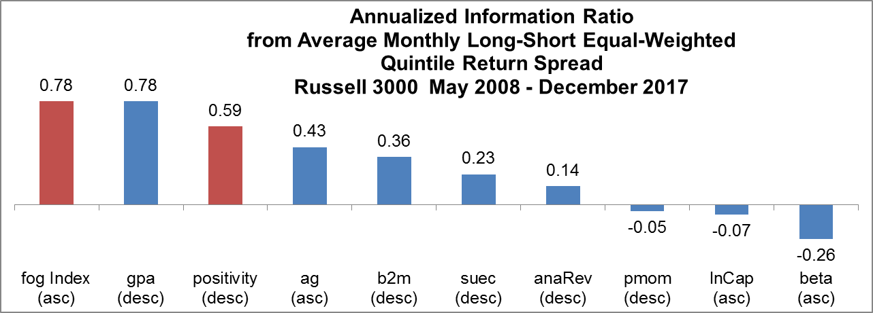
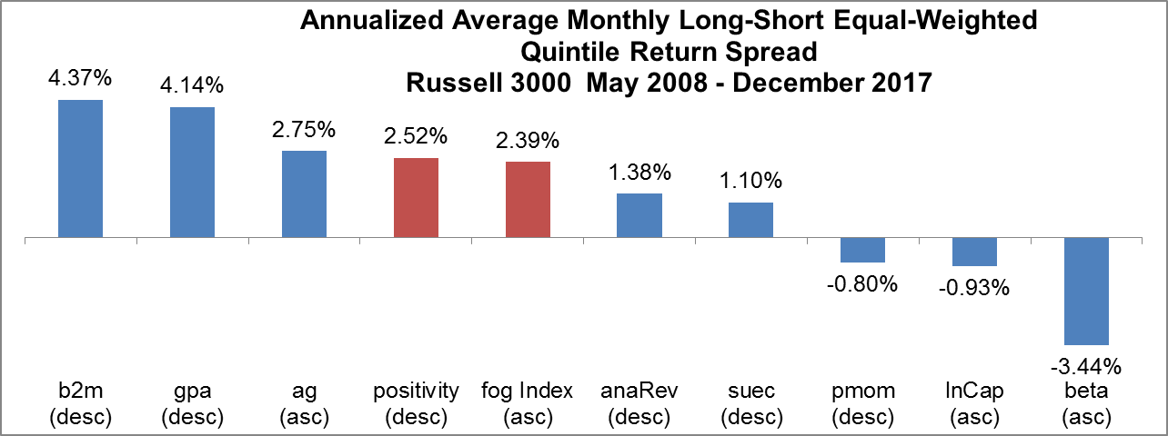
Motivation – Historical Performance Comparison of Strategies
Takeaway:
Stock selection strategies using content from earnings call transcripts were among the best performing strategies in terms of risk-reward trade-off between May 2008 and December 2017 in the Russell 3000 universe. All signals are GICS industry-relative.
Strategies using content from earnings calls
positivity: positive sentiment level (desc)
fog index: Gunning fog index (desc)
Commonly used strategies not from earnings calls
beta: CAPM beta 60-month (asc)
lnCap: natural log market cap (asc)
b2m: book-to-market (desc)
pmom: price momentum 12m-1m (desc)
ag: one-year asset growth % change (asc)
gpa: gross profitability to assets (desc)
anaRev: 3-month analyst revision FY1 EPS (desc)
suec: standardized earnings surprise (desc)
Abbreviations and meaning
asc: signal sorted ascending
desc: signal sorted descending
Source: S&P Global Market Intelligence Quantamental Research as of 02/01/18 (charts are for illustrative purposes only)
10

Slide 11
Earnings Call – Introduction
Description | A conference call between the management of a publicly traded company, sell-side analysts and other attendees to discuss the firm’s latest financial results
Major Sections | Three major sections: i) prepared remarks by executives ii) questions by sell-side analysts iii) unscripted responses by executives to analysts’ questions
Major Participants | Executives (predominately CEOs and CFOs) and analysts; Executives say about 83% of all words (43% in the prepared remarks). Analysts say about 16% of the words in the form of questions.
Length | Average length is 48 minutes.
Sentiment | Average sentiment on calls is positive since calendar Q1 2008 and as of Q4 2017 it is at the highest level in the past 10 years.
See NLP II – Stock Selection for details
Source: S&P Global Market Intelligence Quantamental Research as of 02/01/18 (charts are for illustrative purposes only)
11

Slide 12
Text Preprocessing prior to Signal Construction
Use NLP to convert language into features
Speaker blocks, segmentation (prepared remarks vs. Q&A) and meta-tagging (professional IDs) are done in the data set already
Examples: Tokens, numerical tokens, word tokens, sentences
Text preprocessing specific to earnings calls
Irrelevant speaker types removed (e.g., operator remarks removed)
Generic phrases removed (e.g., good morning, good/great question(s) removed)
Positive and negative negation
Positive negation: We didn’t have a good quarter (not counted as a positive instance)
Negative negation: We didn’t have a bad quarter (highly unlikely to appear, so untreated)
See NLP II – Stock Selection for details
12

Slide 13
Two Main Categories of Signals
Ex-Ante/Intuition
Sentiment-Based
Intuition: Firms whose calls exhibit the most positivity should outperform historically
How is sentiment defined? Leveraging Loughran & McDonald (2011) – Journal of Finance (LM)³
Behavioral-Based
Intuition: When firms experience financial distress (whether transitory or otherwise), executives may soften the bad news by providing different degrees of transparency that are telegraphed directly or indirectly in ways that can be captured quantitatively
Examples: language complexity, the abundance/scarcity of references to numbers and analyst favoritism
³ Loughran, T. and B. McDonald. “When is a Liability not a Liability? Textual Analysis, Dictionaries, and 10-Ks.” Journal of Finance 66, no. 1 (2011): 35-65.

Slide 14
Construction of Sentiment-Based Signals:
Sentiment Level
Leverages Loughran & McDonald (2011) positive and negative sentiment word lists to construct four proxies of sentiment level
Signal | Construction | Sort Order | Intuition
Positivity | # positive words / # total words | D | The frequency of usage of positive words by executives in an earnings call may reveal their (true) sentiment about their firm’s future prospects
Negativity | # negative words / # total words | A | Executives use negative words in an earnings call when compelled to fulfill legal or fiduciary obligations; the absence of negative words is viewed favorably in our narrative
Net Positivity | (# positive words - # negative words) / # total words | D | Takes into account both positive and negative words
Positivity to Negativity | # positive words / # negative words | D | Similar to net positivity but amplifies the magnitude of the difference between positive and negative word frequency
Note: D = descending sort; A = ascending sort
Source: S&P Global Market Intelligence Quantamental Research, as of 02/01/2018.
14

Slide 15
Construction of Sentiment-Based Signals (continued):
Change in Level and Change in Trend
Use the four base metrics (from the previous slide) in the following three ways
Signal | Construction | Sort Order | Intuition
Sentiment Level | Percent of Loughran & McDonald’s sentiment words in a call | D/A | Positivity (or the absence of negativity) reflects bright prospects ahead. See the four base measures of sentiment
Change in Sentiment Level | Sig_{i,t} = (Sig_{i,t} – Sig_{i,t-4}) / Abs(Sig_{i,t-4}) where t is in calendar months and i is for stock i | D | It is the change in the level that is more informative than the level itself
Change in Sentiment Trend | Sig_{(i,t)} = (Sig_{(i,t)} – SMA) / abs(SMA) where SMA = average(Sig_{i,t-1, t-8}) and t is in calendar months and i is for stock i and Sig_{i,t-1, t-8} needs to have a minimum of six calls in the past 24 months | D | Easier to identify inflection points and accelerations
Note: D = descending sort; A = ascending sort
Source: S&P Global Market Intelligence Quantamental Research, as of 02/01/2018.
15

Slide 16
Construction of Behavioral-Based Signals
Intuition: When firms experience financial distress (whether transitory or otherwise), executives may soften the bad news by providing different degrees of transparency that are telegraphed directly or indirectly in ways that can be captured quantitatively
Signal | Construction | Sort Order
Transparency: Language Complexity | Gunning Fog Index = 100 * (average words per sentence + % of polysyllabic words in a call) where the polysyllabic cutoff is 3+ syllables | A
Transparency: Presenting Using More Numbers | Ratio = Numerical Tokens / Total Word Tokens | D
Transparency: Analyst Favoritism | % Difference = (A – B) / Abs(B) A = average metric of analysts called on B = average metric of analysts not called on metric = {FY1 EPS estimate, price target, numerical stock recommendation} | A
Note: D = descending sort; A = ascending sort
Source: S&P Global Market Intelligence Quantamental Research, as of 02/01/2018.
16

Slide 17
Description of Empirical Results
Description of analysis:
Monthly rebalancing at month-end: Look-back window - 4 months
Assessed each signal using spearman correlation, long less benchmark, long-short, information ratio and portfolio hit rate
Industry-neutral signals to mitigate industry tilts at the GICS industry level
Performance values that are shaded in green are statistically significant at least at the 10% level (i.e., 90+% confident that the results aren’t zero)
Source: S&P Global Market Intelligence Quantamental Research as of 02/01/18 (charts are for illustrative purposes only)
17

Slide 18
Sentiment-Based Signals Empirical Results

Slide 19
Sentiment Based Signals – Entire Transcripts
Takeaway:
Sentiment level, change in sentiment level and change in sentiment trend are predictive historically with good economic contribution from the long-side of the strategies (i.e., 50+% column 7 versus 10)
Source: S&P Global Market Intelligence Quantamental Research as of 02/01/18 (charts are for illustrative purposes only)
19

Slide 20
Behavioral-Based Signals Empirical Results

Slide 21
Behavioral-Based Signals
Takeaway:
Firms whose executives use simpler language (row 1) and use more numbers outperform historically (row 3)
Firms whose executives seem to play favoritism by selectively calling on more bullish analysts (using average EPS estimates, recommendations or price targets) do not underperform historically⁴
Firms where the collective forecasts of analysts, who are called on to ask questions, have the least discordance outperform historically (row 5)
One plausible explanation is that firms whose executives provide more transparency result in a smaller discordance in analysts forecasts because analysts need to make less (subjective) assumptions⁵
Source: S&P Global Market Intelligence Quantamental Research as of 02/01/18 (charts are for illustrative purposes only)
⁴ Contrary to Cohen, L., Lou D. and Malloy C. J. “Playing Favorites: How Firms Prevent the Revelation of Bad News.” SSRN August 13 2014 https://papers.ssrn.com/sol3/papers.cfm?abstract_id=2479542
⁵ Ali, A., Liu, M., Xu, D., and Yao, T., “Corporate Disclosure, Analyst Forecast Dispersion, and Stock Returns” (August 2012 2001).
SSRN: https://papers.ssrn.com/sol3/papers.cfm?abstract_id=556704
21
21

Slide 22
Controlling for Risk and Alpha Signals

Slide 23
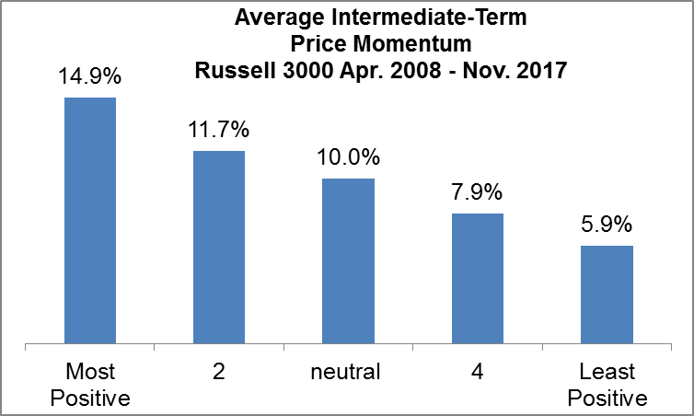
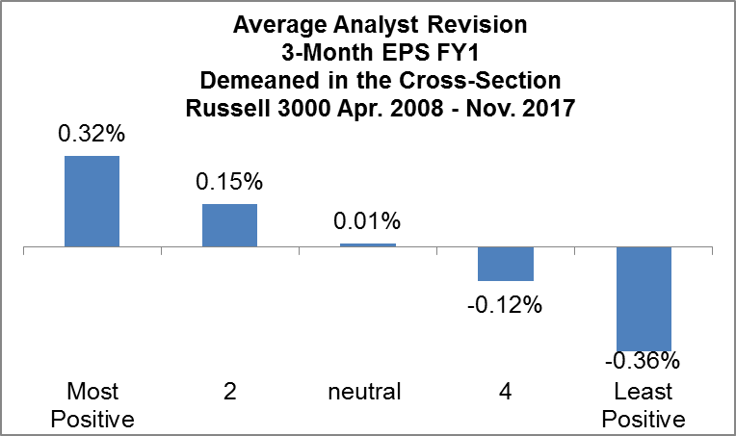
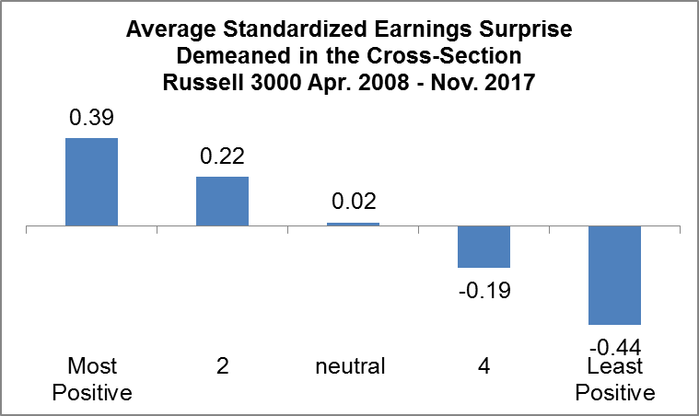
Natural Tilts of Sentiment-Based Signals
Description:
Using positive sentiment level strategy as an example
Natural tilts to
Price momentum 12m – 1m (upper right)
Analyst revision (middle chart)
Earnings Surprise (lower chart)
Takeaway:
Need to adjust for the tilts to ensure the predictive power isn’t just a manifestation of or is subsumed by these natural tilts
Source: S&P Global Market Intelligence Quantamental Research as of 02/01/18 (charts are for illustrative purposes only)
23

Slide 24
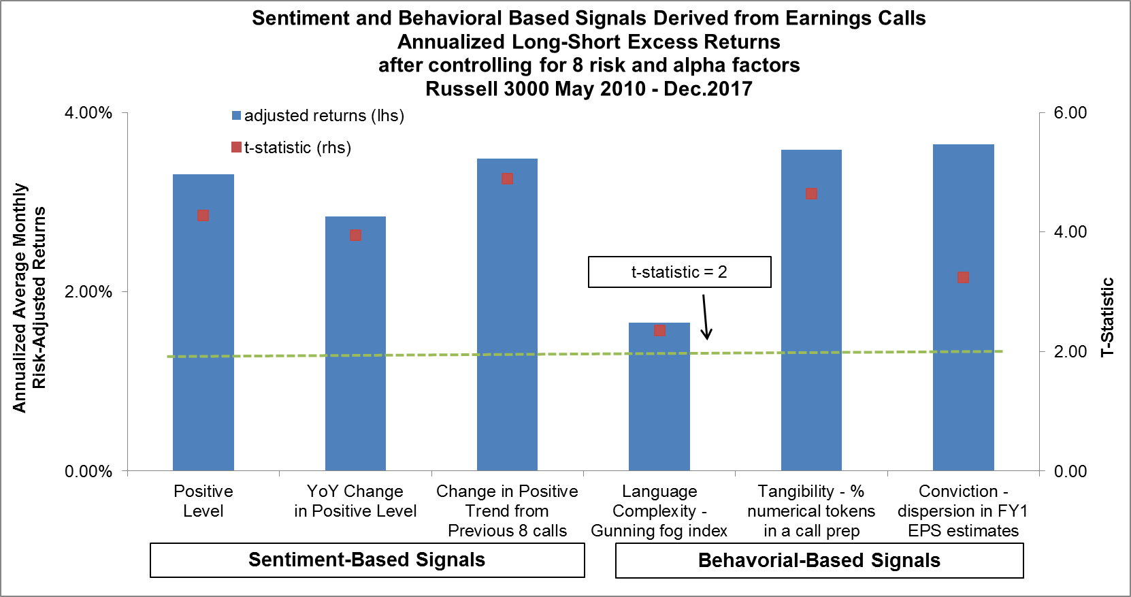
Results after control for risk and alpha factors
Takeaway:
Stock selection strategies that are constructed using the content from earnings call transcripts show historical economic and statistical significance after controlling for (CAPM) beta, size, value, price momentum, asset growth, gross profitability, analyst revision and earnings surprise between May 2010 and December 2017 in the Russell 3000 universe. All signals are relative at the GICS industry level.
Source: S&P Global Market Intelligence Quantamental Research as of 02/01/18 (charts are for illustrative purposes only)
24

Slide 25
Correlations
Description:
Correlations of long-short equal-weighted quintile return spreads between May 2010 and December 2017 inclusive in the Russell 3000 universe
Takeaway:
Sentiment- and behavioral-based signals are lowly-/negatively-correlated
There are diversification benefits to be had when the two types of signals are blended together
Source: S&P Global Market Intelligence Quantamental Research as of 02/01/18 (charts are for illustrative purposes only)
25

Slide 26
Takeaways - Empirical Results
Historically, sentiment- and behavioral-based signals that are constructed from the content in earnings call transcripts are among the best strategies in terms of risk-reward trade-off (i.e., information ratio) in the last 10 years in the U.S. equity market with decent economic performance ranging from 2% - 5% per annum.
Historically, sentiment- and behavioral-based signals have had incremental predictive power above and beyond common risk and alpha factors.
Sentiment- and behavioral-based signals that are derived from the content in earnings call transcripts are lowly correlated. A multi-factor strategy that blends the two categories of signals should yield a composite signal that is more predictive yet with a lower volatility.
26

Slide 27
Copyright © 2019 by S&P Global Market Intelligence, a division of S&P Global Inc. All rights reserved.
These materials have been prepared solely for information purposes based upon information generally available to the public and from sources believed to be reliable. No content (including index data, ratings, credit-related analyses and data, research, model, software or other application or output therefrom) or any part thereof (Content) may be modified, reverse engineered, reproduced or distributed in any form by any means, or stored in a database or retrieval system, without the prior written permission of S&P Global Market Intelligence or its affiliates (collectively, S&P Global). The Content shall not be used for any unlawful or unauthorized purposes. S&P Global and any third-party providers, (collectively S&P Global Parties) do not guarantee the accuracy, completeness, timeliness or availability of the Content. S&P Global Parties are not responsible for any errors or omissions, regardless of the cause, for the results obtained from the use of the Content. THE CONTENT IS PROVIDED ON “AS IS” BASIS. S&P GLOBAL PARTIES DISCLAIM ANY AND ALL EXPRESS OR IMPLIED WARRANTIES, INCLUDING, BUT NOT LIMITED TO, ANY WARRANTIES OF MERCHANTABILITY OR FITNESS FOR A PARTICULAR PURPOSE OR USE, FREEDOM FROM BUGS, SOFTWARE ERRORS OR DEFECTS, THAT THE CONTENT’S FUNCTIONING WILL BE UNINTERRUPTED OR THAT THE CONTENT WILL OPERATE WITH ANY SOFTWARE OR HARDWARE CONFIGURATION. In no event shall S&P Global Parties be liable to any party for any direct, indirect, incidental, exemplary, compensatory, punitive, special or consequential damages, costs, expenses, legal fees, or losses (including, without limitation, lost income or lost profits and opportunity costs or losses caused by negligence) in connection with any use of the Content even if advised of the possibility of such damages.
S&P Global Market Intelligence’s opinions, quotes and credit-related and other analyses are statements of opinion as of the date they are expressed and not statements of fact or recommendations to purchase, hold, or sell any securities or to make any investment decisions, and do not address the suitability of any security. S&P Global Market Intelligence may provide index data. Direct investment in an index is not possible. Exposure to an asset class represented by an index is available through investable instruments based on that index. S&P Global Market Intelligence assumes no obligation to update the Content following publication in any form or format. The Content should not be relied on and is not a substitute for the skill, judgment and experience of the user, its management, employees, advisors and/or clients when making investment and other business decisions. S&P Global Market Intelligence does not act as a fiduciary or an investment advisor except where registered as such. S&P Global keeps certain activities of its divisions separate from each other in order to preserve the independence and objectivity of their respective activities. As a result, certain divisions of S&P Global may have information that is not available to other S&P Global divisions. S&P Global has established policies and procedures to maintain the confidentiality of certain non-public information received in connection with each analytical process.
S&P Global may receive compensation for its ratings and certain analyses, normally from issuers or underwriters of securities or from obligors. S&P Global reserves the right to disseminate its opinions and analyses. S&P Global's public ratings and analyses are made available on its Web sites, www.standardandpoors.com (free of charge) and www.ratingsdirect.com (subscription), and may be distributed through other means, including via S&P Global publications and third-party redistributors. Additional information about our ratings fees is available at www.standardandpoors.com/usratingsfees.
27

